Slide 1
Abbulu - Capstone Project The Battle of Neighborhoods Final Presentation

Slide 2
Introduction / Business Problem When someone wants to move to a new city, they would like to know what the place can offer in terms of variety of Coffee shops, Restaurants, Entertainment places, Parks, etc. With that information in hand, an individual would be able to make an informed decision on which city and neighborhood to move and live there. For this project, I chose to compare two cities, namely San Francisco and Seattle and their neighborhoods. I believe there are three groups that would benefit from this work. 1. College students, after graduation, make a decision on which city to move for work. 2. Mid-career professionals, who want to move to a new city for better job opportunities. 3. Immigrants who would like to compare cities to relocate to emigrate.

Slide 3
Data I’ll need a list of neighborhoods in San Francisco and Seattle. I’ve used Wikipedia’s neighborhood data for these two cities and then gather geospatial details i.e. latitude and longitude using geolocator. San Francisco Neighborhoods: https://en.wikipedia.org/wiki/List_of_neighborhoods_in_San_Francisco Seattle Neighborhoods: https://en.wikipedia.org/wiki/List_of_neighborhoods_in_Seattle Example data for San Francisco Neighborhood Latitude Longitude Presidio 37.7987456 -122.464588924107 Example data for Seattle Neighborhood Latitude Longitude Westlake 47.6328217 -122.341842560126

Slide 4
Methodology 1. Create dataframes with all neighborhoods for San Francisco and Seattle. 2. Use Geolocator to get latitude and longitude for each of the neighborhoods. 3. Create a map of San Francisco and Seattle showing the neighborhoods. 4. Use Four Square API to, a. get all venues within a 500 meter radius. b. get category of each venue. c. get venues details d. get count of venues for each neighborhood 5. Get top 5 most and top 10 venues in each neighborhood 6. Create clusters of neighborhoods a. use “one hot encoding” to prepare data for cluster creation b. aggregate each venue by neighborhood and by taking the mean of the frequency of occurrence of each category. c. model using k-means to cluster the neighborhood into 5 clusters. 7. Create dataframe that combines the cluster data as well as the top 10 venues for each neighborhood. 8. Examine each cluster and determine the discriminating venue categories that distinguish each cluster.

Slide 5
Results San Francisco – Neighborhood clusters San Francisco has 5 clusters of neighborhoods Cluster 1: Consists of 25 neighborhoods Cluster 2: Consists of 6 neighborhoods Cluster 3: Consists of 1 neighborhood Cluster 4: Consists of 3 neighborhoods Cluster 5: Consists of 1 neighborhood

Slide 6
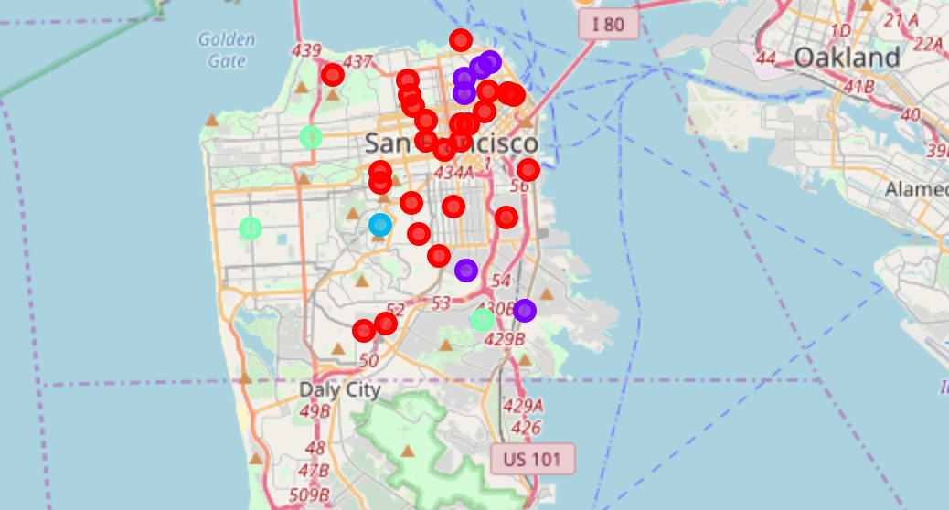
Results San Francisco – Neighborhood clusters map

Slide 7
Results Seattle – Neighborhood clusters Seattle has 5 clusters of neighborhoods Cluster 1: Consists of 1 neighborhood Cluster 2: Consists of 6 neighborhoods Cluster 3: Consists of 2 neighborhoods Cluster 4: Consists of 36 neighborhoods Cluster 5: Consists of 1 neighborhood

Slide 8
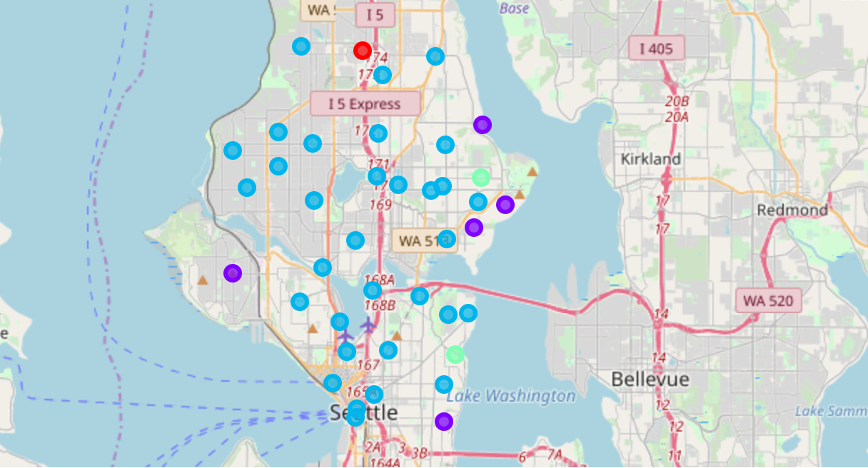
Results Seattle – Neighborhood clusters map

Slide 9
Discussion There are two main clusters in San Francisco as well as in Seattle San Francisco has 5 clusters of neighborhoods Cluster 1: Consists of 25 neighborhoods Cluster 2: Consists of 6 neighborhoods Seattle has 5 clusters of neighborhoods Cluster 2: Consists of 6 neighborhoods Cluster 4: Consists of 36 neighborhoods It’s observed majority of the neighborhoods both in San Francisco and Seattle fall into one cluster. That’s an insight that I didn’t know before. I believe that highlights the specific character of each city.

Slide 10
Conclusion The clustering analysis shows, San Francisco and Seattle have some similar neighborhoods. By comparing the top venues in each of the similar neighborhoods, it helps one to chose a city and neighborhood that fits their choice.

